Slide 1
Lecture 9 ➔ Video and ➔ Natural Language Processing
András Lőrincz
Department of Artificial Intelligence
Faculty of Informatics

Slide 2
Up to this point
Image
Speech
(Control)
Now: Image series with speech and
Natural Language Processing
Aims: situation understanding for acting and planning
Next lecture
BKP Horn: Vision is inverse graphics
AL: Vision is inverse animation in 3D

Slide 3
Motion: Optical Flow (Perceiving Systems)
Color coded: color show direction of motion
Intensities show speed of motion

Slide 4
Optical Flow can be fooled (Perceiving Systems)

Slide 5
Video ELTE – Martonvásár 1

Slide 6
Video ELTE – Martonvásár 2

Slide 7
Video ELTE – Martonvásár 3

Slide 8
Video and speech → Speaker separation
code: https://www.cse.huji.ac.il/~arielephrat/

Slide 9
Natural Language Processing It is complicated… Here is a story with a question for you
In a community, many people know that Smith is corrupt.
X claims it openly. He says: Smith is a currupt person!
Smith takes this issue to the local court and – unfortunately – X can’t prove a single case of corruption. He looses…
The decision of the court is that on the next Sunday, X must stand up in front of the community and say:
„Mr Smith, you are a honest member. I do apologize!”
X stands up and says the required words with 100% percision.
However, the meaning remains the same: Smith is corrupt.
How come? What is your solution?

Slide 10
Solution Type 2 is highlighted
IT IS EASY TO CHANGE THE MEANING…
BY GESTURES
IT IS ALSO EASY TO „TELL SOMETHING” WITH GESTURES

Slide 11
Winks combined with other gestures can have different meanings
I tricked him!
You tricked him!
Yes. OK.
I told you!
You bet!
Let’s go!
Deal…
Did you get it?
I did get it!
Bad boy…

Slide 12
Natural Language Processing
Can be very hard... Meaning depends on little details
Józsi (Joseph) ismeri (knows) Marit. (Mari-ACC) (for sure)
Józsi Marit ismeri. (only Mari)
Marit Józsi ismeri. (only Józsi)
Marit ismeri Józsi. (not only Mari is known by Józsi)
Ismeri Marit Józsi. (not only Józsi knows Mari)
Ismeri Józsi Marit. (Józsi knows Mari – a fact)
https://www.ucl.ac.uk/~uczaksz/Szendroi%202003.pdf
Bad / wrong /erroneous opinion:
https://algorithmia.com/blog/introduction-natural-language-processing-nlp
“Nat­ur­al Lan­guage Pro­cessing is a field that cov­ers com­puter un­der­stand­ing and ma­nip­u­la­tion of hu­man lan­guage, and it’s ripe with pos­sib­il­it­ies for news­gath­er­ing,”
Although it is true, but there is no understanding of any kind...
Recall the Chinese Room example

Slide 13
Language model tools
https://theappsolutions.com/blog/development/nlp-tools/
8 Best NLP Tools and libraries
NLTK
Stanford Core NLP
Apache OpenNLP
SpaCy
AllenNLP
GenSim
TextBlob Library
Intel NLP Architect

Slide 14
1. NLTK – entry-level open source NLP Tool
Natural Language Toolkit (aka NLTK) is powered with Python NLP.
NLTK provides users with a basic set of tools for text-related operations. It is a good starting point for beginners
Natural Language Toolkit features include:
Text classification, Part-of-speech tagging, Entity extraction, Tokenization, Parsing, Stemming, Semantic reasoning
NLTK interface includes text corpora and lexical resources:
Penn Treebank Corpus, Open Multilingual Wordnet, Problem Report Corpus, and Lin’s Dependency Thesaurus
Such technology allows extracting many insights, including customer activities, opinion, and feedback. NLTK is useful for simple text analysis.

Slide 15
2. Stanford Core NLP – Data Analysis, Sentiment Analysis, Conversational UI
Unlike NLTK, Stanford Core NLP is a perfect choice for processing large amounts of data and performing complex operations.
With its high scalability, Stanford CoreNLP is an excellent choice for:
information scraping from open sources (social media, user-generated reviews)
sentiment analysis (social media, customer support)
conversational interfaces (chatbots)
text processing, and generation (customer support, e-commerce)

Slide 16
ChatBots
10 Best Chatbot Builders in 2020 - Venture Harbour
#1: Mobile Monkey
#2: Leadformly
#3: TARS
#4: Flow XO
#5: Botsify
#6: ChatterOn
#7: Sequel
#8: Pandorabots
#9: Chatfuel
#10: Botkit

Slide 17
☺ The 7 Best Chatbots of 2020 - Userlike
#1 HelloFresh’s Freddy
#2 Capital One’s Eno
#3 World Health Organization’s WHO Health Alert
#4 Amtrak’s Julie
#5 OMQ Chatbot
#6 KLM’s BB
#7 AskBenji
No overlap...

Slide 18
A sample from recent methods
A few slides from
Abigail See’s lecture
Part of NLP course 224n (Stanford)
An RNN is a temporal (deep) network.
For a given input or input series it derives an output series step-by-step
Many architectures
Many tricks

Slide 19
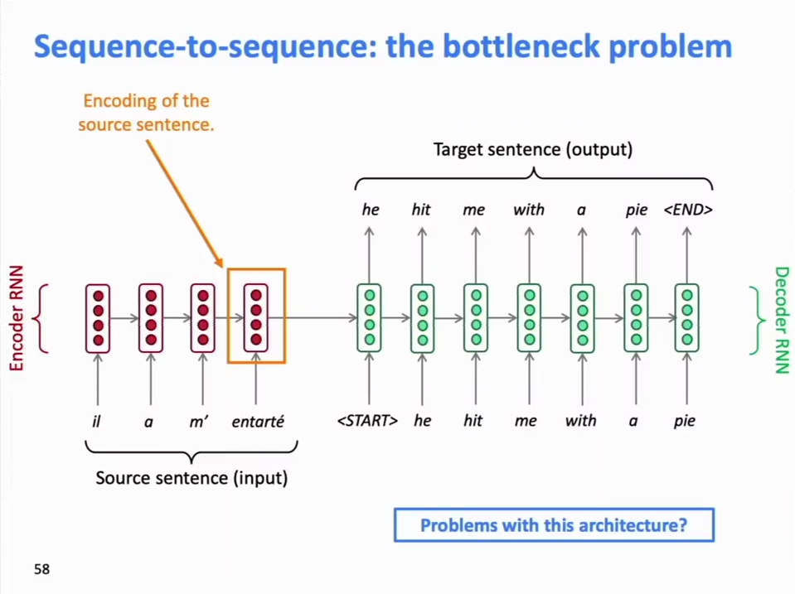
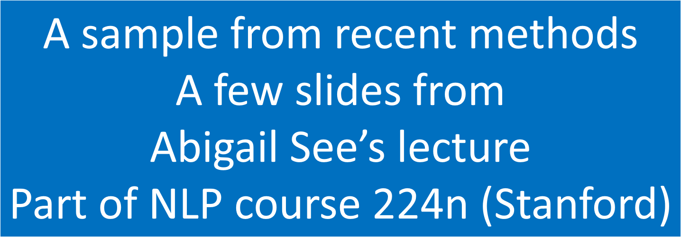
RNN → Sequence-to-sequence → seq2seq
Transforming a sequence to another one, e.g., translation
representation
after receiving the
n^{th} input
representation
of the
1st output
representation
of the
4th output

Slide 20
Problem with the architecture
backpropagation
path is too long
gradient vanishes
representation
after receiving the
n^{th} input
representation
of the
1st output
representation
of the
4th output

Slide 21
the bottleneck

Slide 22
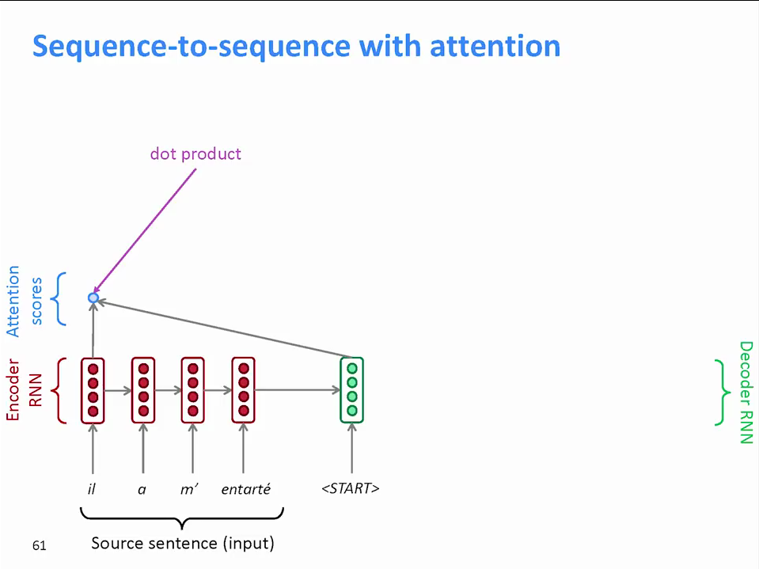

Slide 23
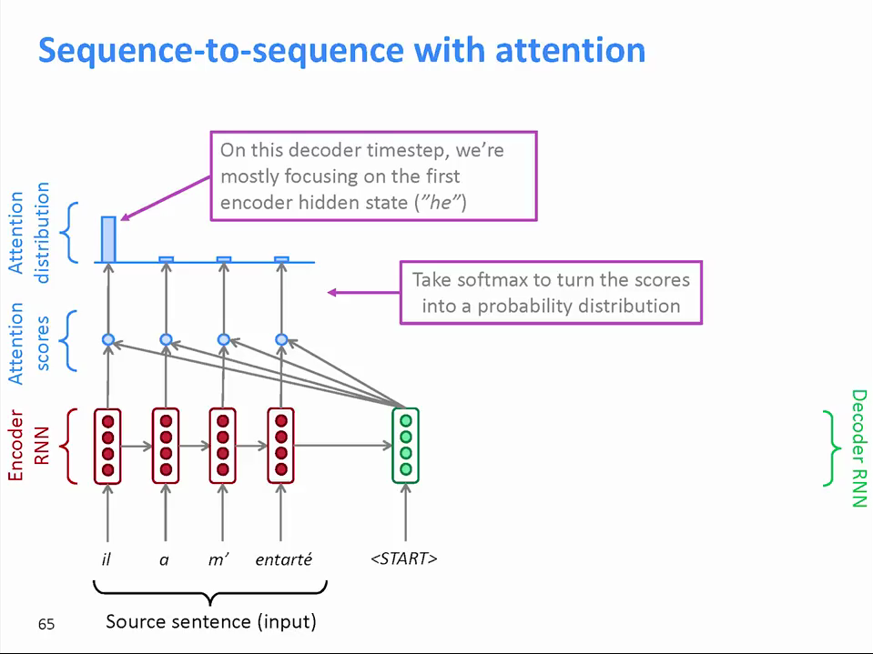

Slide 24
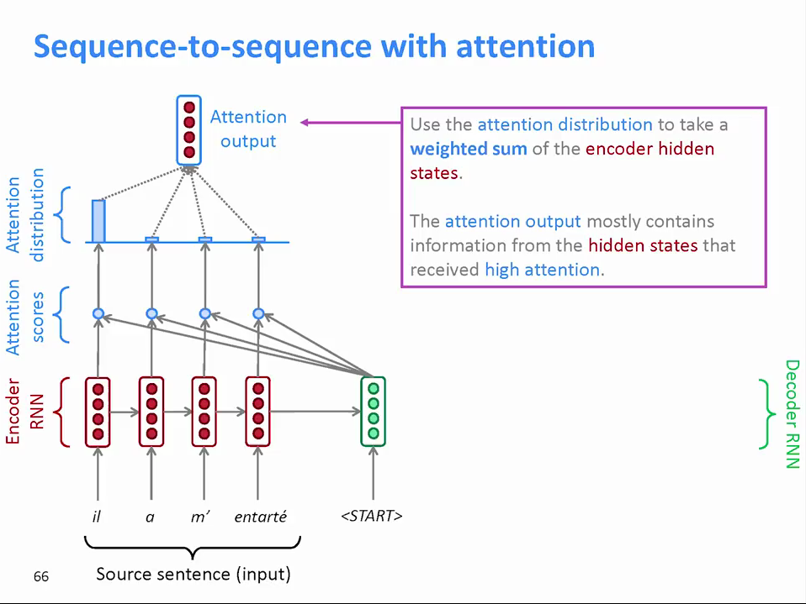

Slide 25
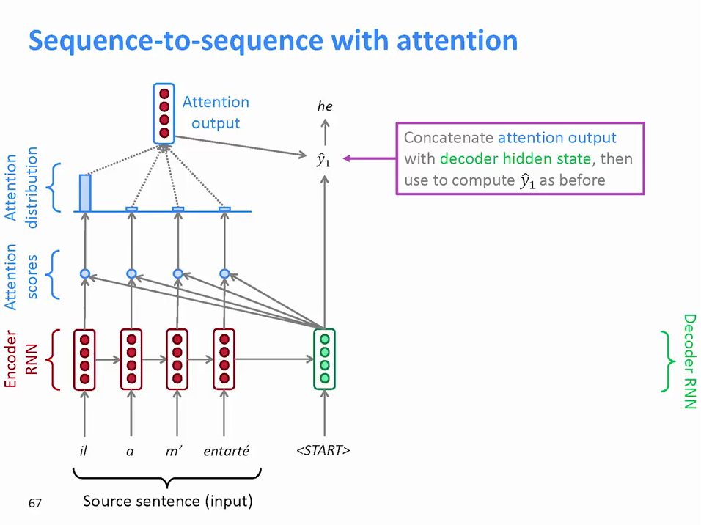
„Concatenate sg. with sg” means:
„use both”
If you concatenate
vector x of dim n with
vector y of dim m you get
vector z of dim(n+m)

Slide 26
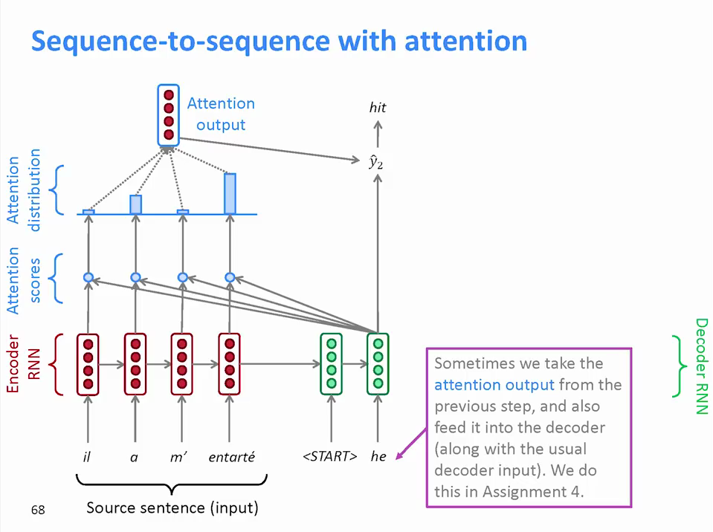

Slide 27
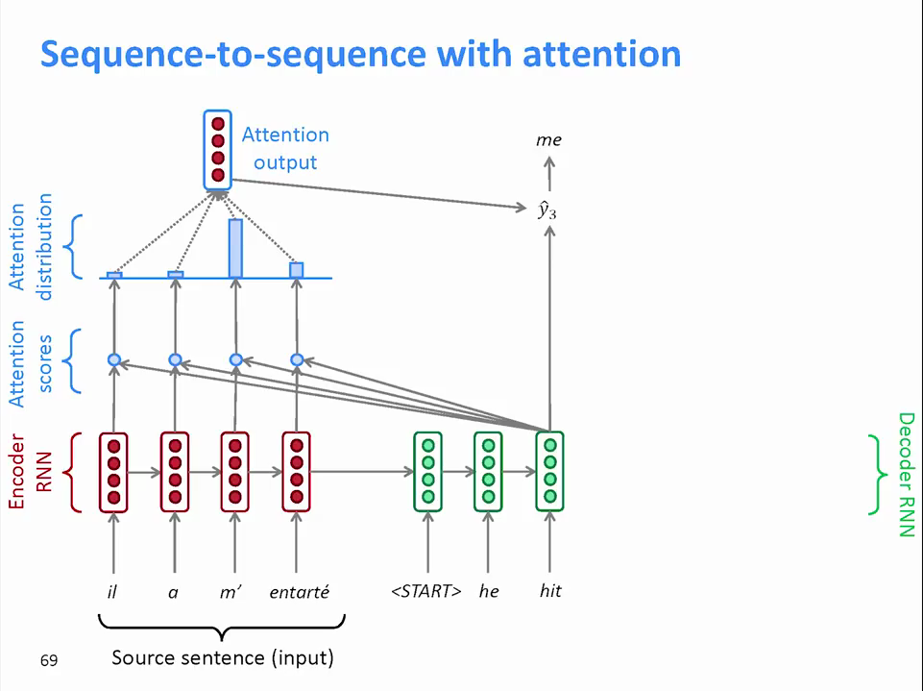

Slide 28
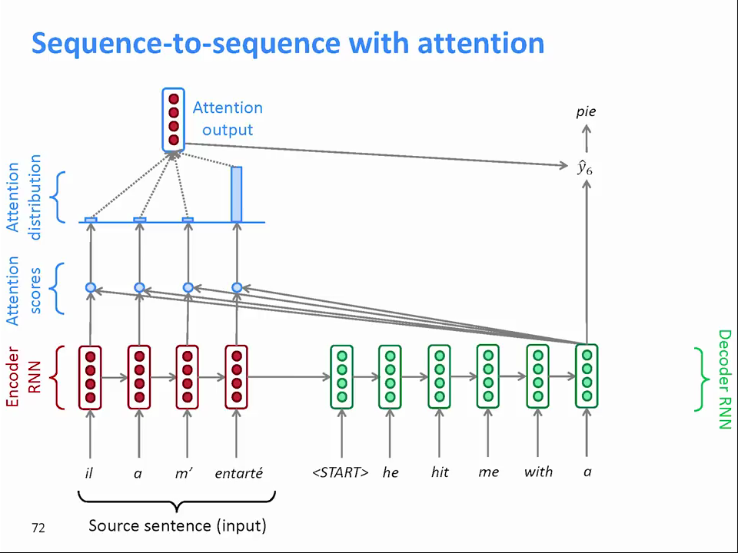

Slide 29
Names
Query
Key
Value
Attention score vector
Attention etc. are trained on many examples where we know the correct translation
It is interesting that the method is strong and can generalize for other sentences
The estimated training cost of GPT-3 (Google) is USD 2,5 million

Slide 30
Attention and Transformers
Attention is one of the most important recent concepts in DNN technology
It has almost nothing to do with the concept of attention in psychology
An extension of attention is called transformers
The word comes from the word translation (linguistics)
It has gained popularity in many fields where temporal information is relevant, including the fusion of modalities
Check the quality of Google translate
What does the Hungarian word „láb” means?
Answer:
A láb az állatok egy részénél a szilárd aljzaton való helyváltoztatás szerve melyet neveznek mozgásszervnek vagy végtagnak is. Orvosi (ortopédiai) értelemben a láb, az alsó végtagnak a bokaízületen túli része.

Slide 31
This
is the
END!
lorincz@inf.elte.hu

